Slide 1
Customer Personality Analysis
MENTOR NAME : M. KARTHIK
BATCH MEMBERS
1. ESHAN PANDEY
2. MANJUNATH.N
3. PRASANNA HEDAOO

Slide 2
OBJECTIVE
Customer personality analysis helps businesses efficiently target marketing efforts, personalize products, improve customer engagement, optimize resource allocation, boost retention, and predict trends by understanding specific customer preferences and behaviors. For example, a company launching a new fitness product can focus on health-conscious segments, tailor marketing campaigns, and adjust strategies based on segment response.

Slide 3
DATA SUMMARY
In this project we have taken a “marketing campaign” as a data set.
In the marketing champaign file there are some attributes. They are :
1. People
2. Products
3. Promotion
4. Place

Slide 4
EXPLORATORAY DATA ANALYSIS

Slide 5
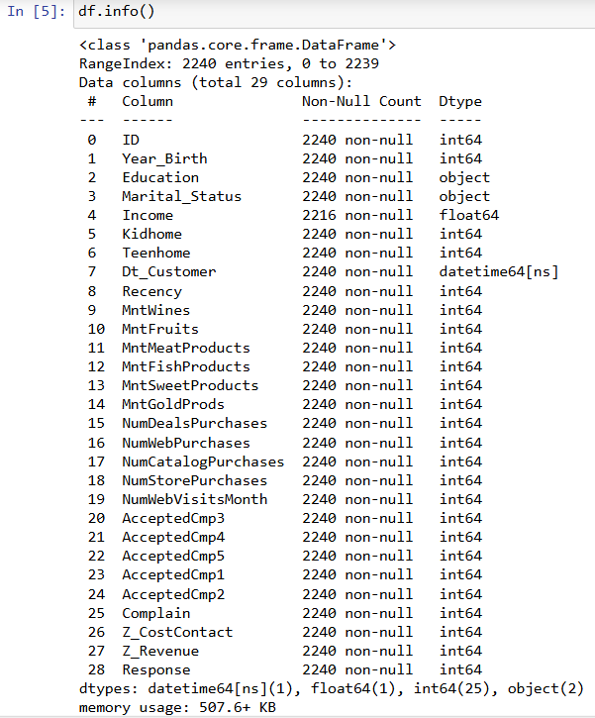
DATA INFORMATION
There are all non values which are present in the data set.

Slide 6
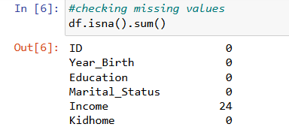
CHECKING THE MISSING VALUES
While checking the missing the missing values, we found that “INCOME” column has 24 missing values.

Slide 7
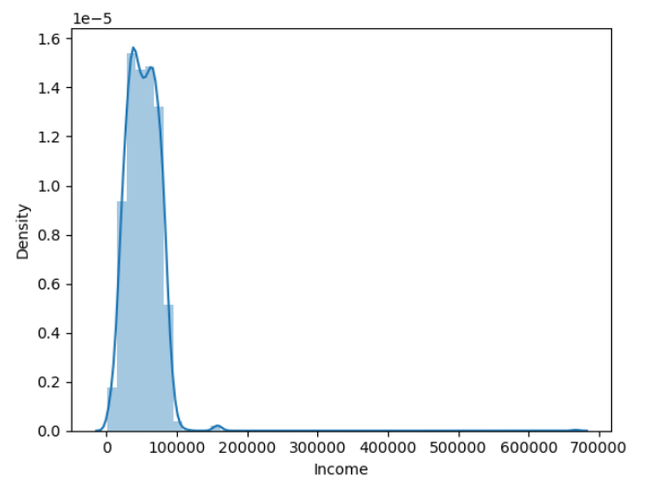
HANDLING THE MISSING VALUES
The skewness of the “INCOME” column is 6.76 which we can say that it is rightly skewed data.
The kurtosis of the “INCOME” column is 159.63 that is leptokurtic curve.

Slide 8
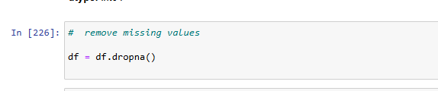
Dropping all the null values by using dropna function.

Slide 9
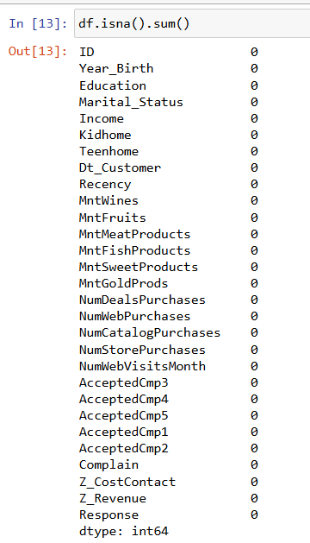
RE-CHECKING THE NULL VALUES

Slide 10
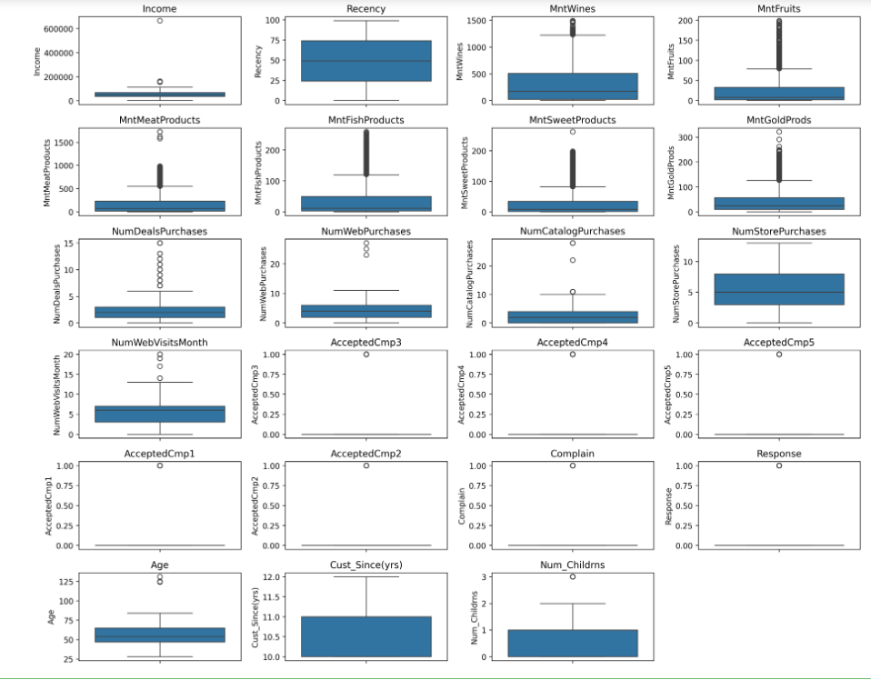
BOX-PLOTS
The boxplots are arranged in a grid layout, dynamically adjusting the number of rows and columns to fit all the plots. This visualization helps identify the outliers.
Here we can see the many of columns are having outliers.

Slide 11
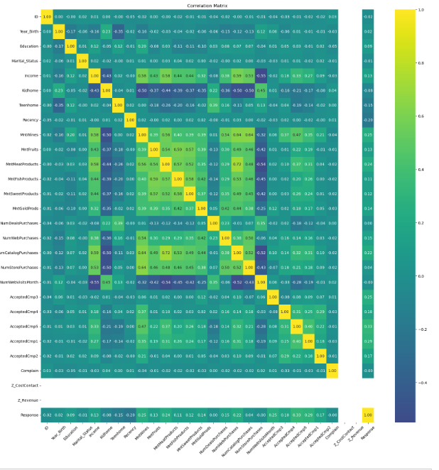
HEAT MAP
The correlation matrix for the Data Frame and visualizes it using
a heatmap. The heatmap provides a visual representation of the
linear relationships between the variables in df, with annotations
showing the exact correlation coefficients. The plot is customized
with rotated axis labels, a centered colormap, and a specific color
scheme to enhance readability and interpretation

Slide 12
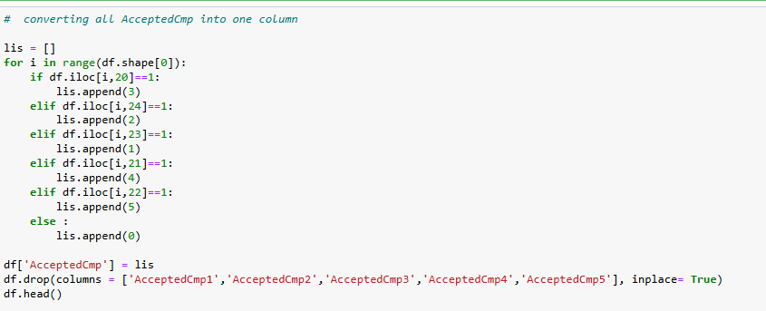
CONVERTING MANY COLUMNS INTO ONE
Converting many columns into one column, because to reduce the dimentionality in the data set.

Slide 13
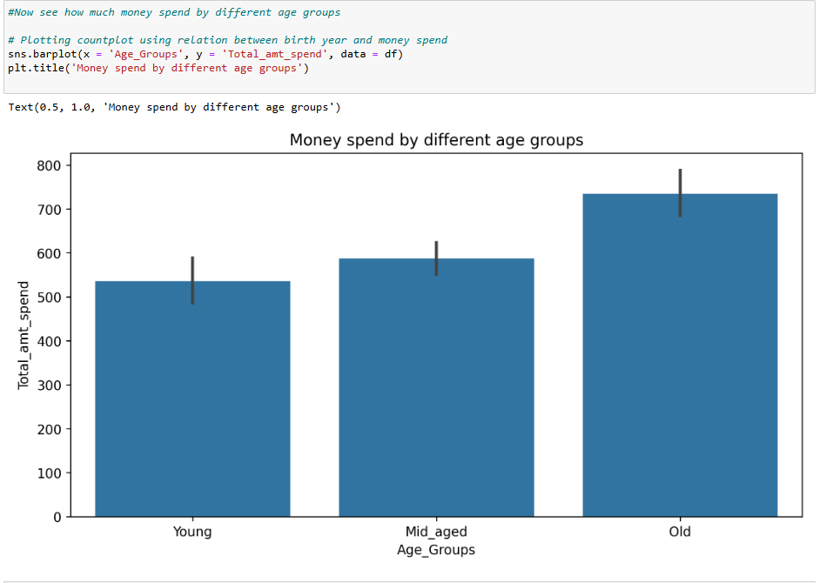
CHEKING OUT THE WHICH CATEGORY OF THE CUSTOMERS SPENDING MORE MONETY
Here we can see that “old age “ persons are spending more money for buying the products.

Slide 14
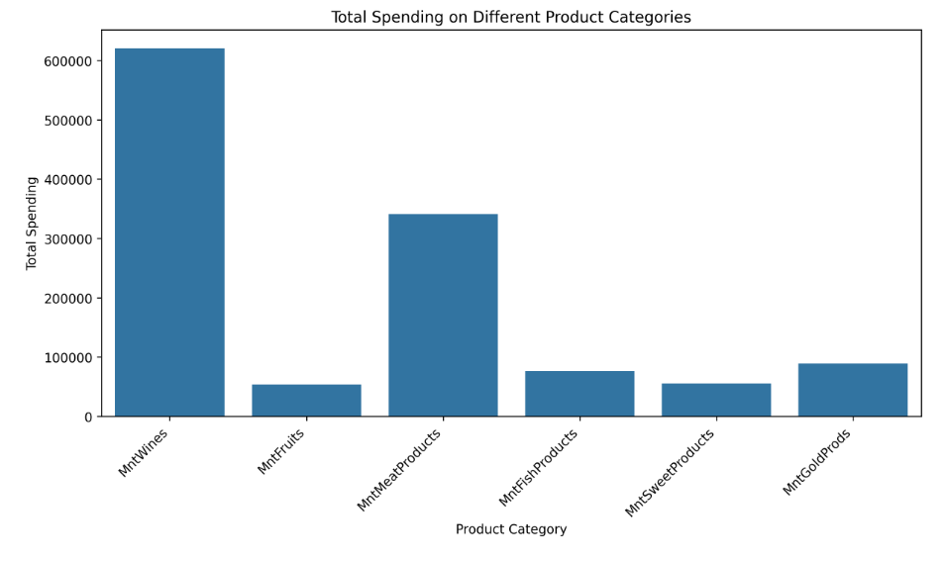
BEST SELLING PRODUCT
“WINE” is the best selling product it is spending around 600000.
And the second best selling product is “mntmeatproduct” , it is spending around 350000.

Slide 15
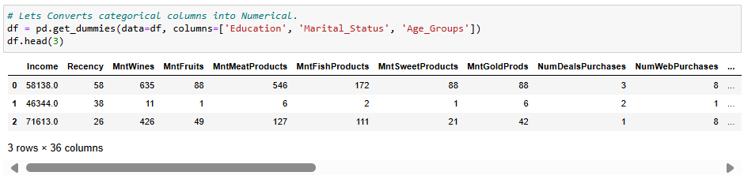
CONVERTING CATEGORICAL COLUMNS INTO NUMERICAL

Slide 16
CLUSTERING MODEL BUILDING

Slide 17
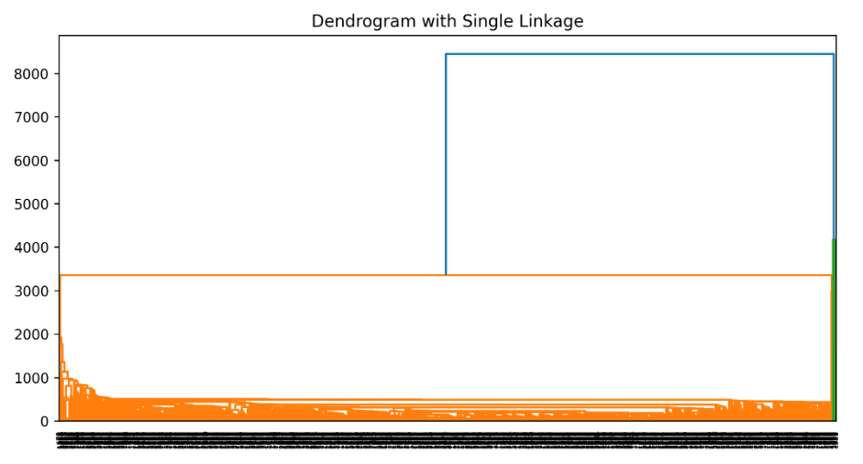
HIERARCHICAL CLUSTERING
Because of huge dataset, the hierarchical clustering is poor performance with mixed data set.
Hierarchical clustering struggles with missing values. So we cannot depends upon hierarchical clustering.

Slide 18
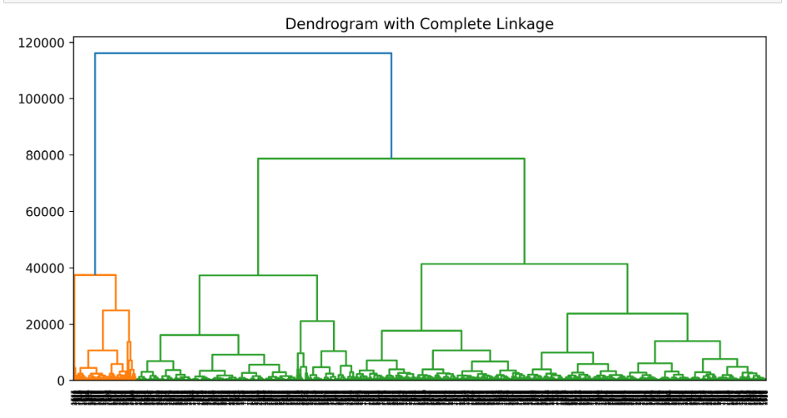
HIERARCHICAL CLUSTERING WITH COMPLETE LINKAGE METHOD
Complete linkage will create a well separated compact clusters, but we suffer from chaining effects and sensitivity due to outliers.
It not performed well on very large data sets due to computational complexity.

Slide 19
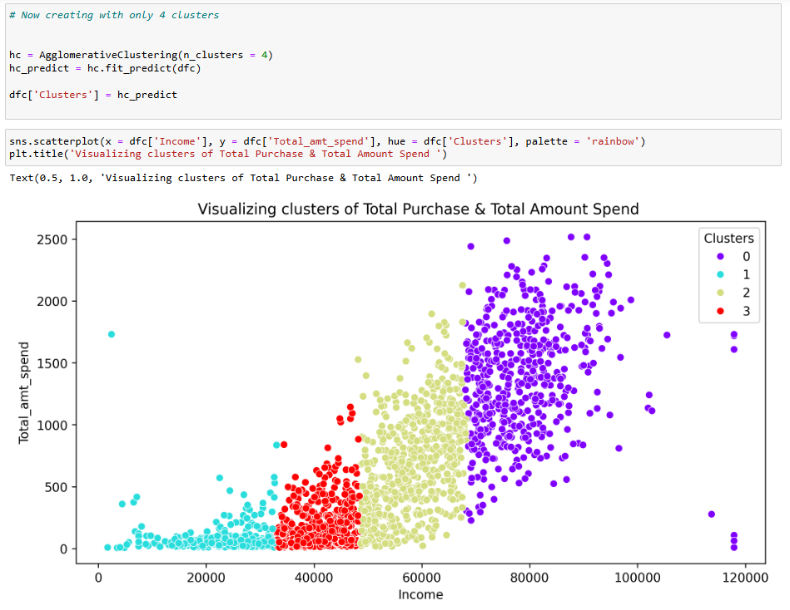
AGGLOMERATIVE CLUSTERING (n_CLUSTERS = 4)

Slide 20
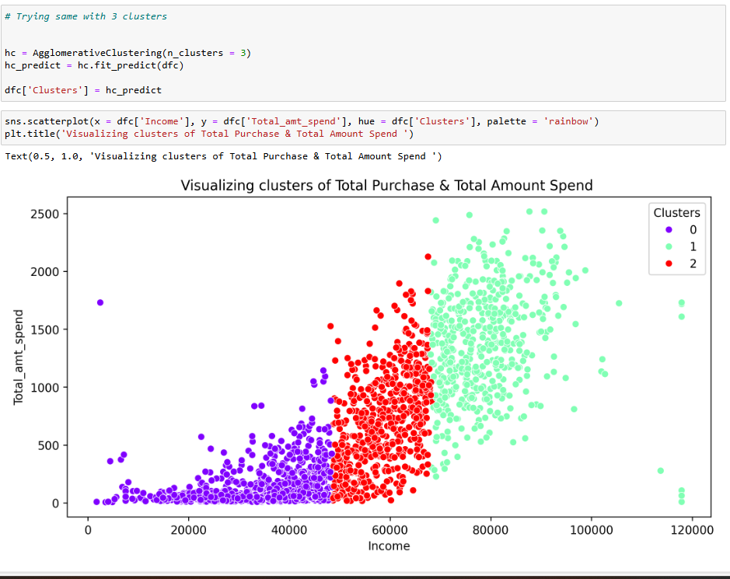
AGGLOMERATIVE CLUSTERING (N_CLUSTERS=3)

Slide 21
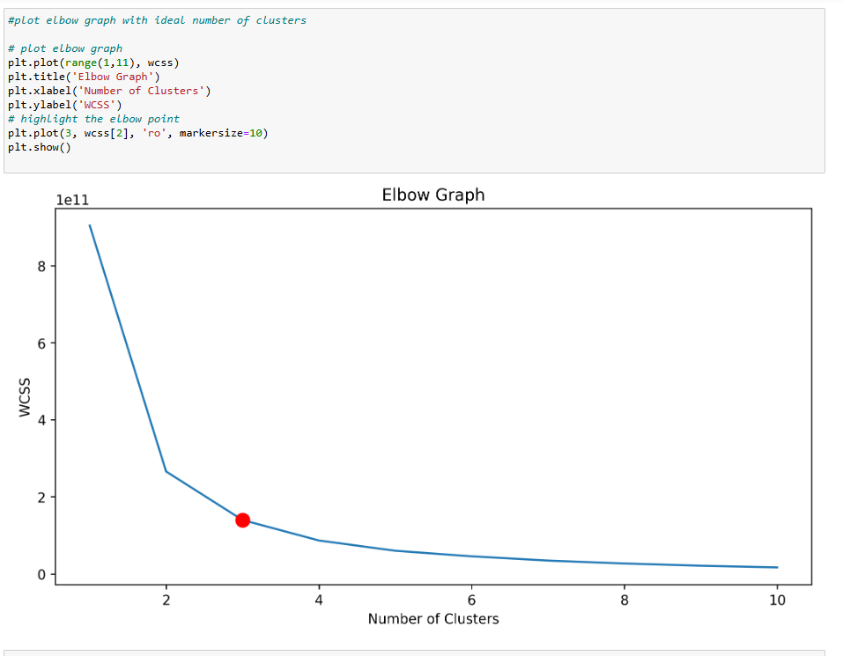
K-MEANS CLUSTERING
We have created 8 clusters, by applying k-means clustering.
We plotted elbow graph to get a ideal numbers of clusters and to perform hyper parameter tuning.
And we found that 3 is the optimal number to be made.

Slide 22
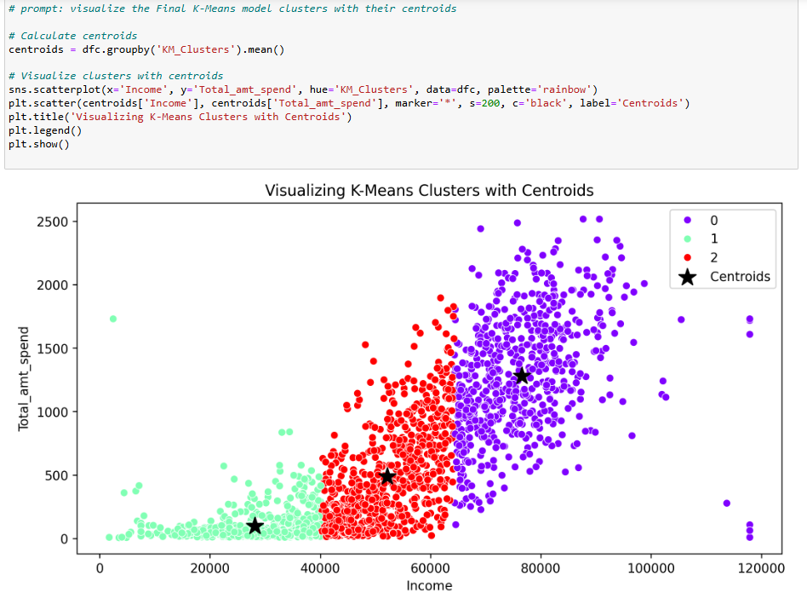
Visualizing k-means clustering with centroids

Slide 23
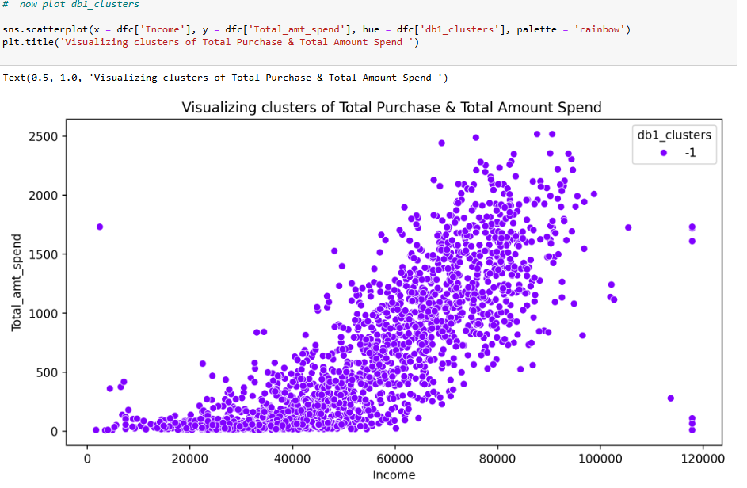
Dbscan clusters of amount spend and total purchase

Slide 24
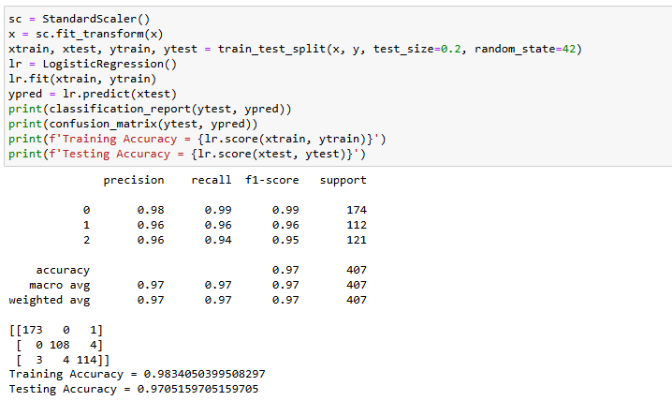
Model deployment
By using a standard scaler, we splitted a data into training and testing, by using logistic regression as model.
We got 97% as accuracy, so we do think it is a good model.

Slide 25
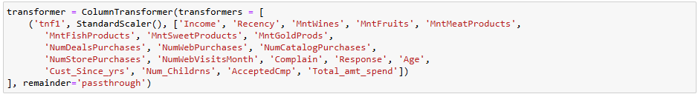
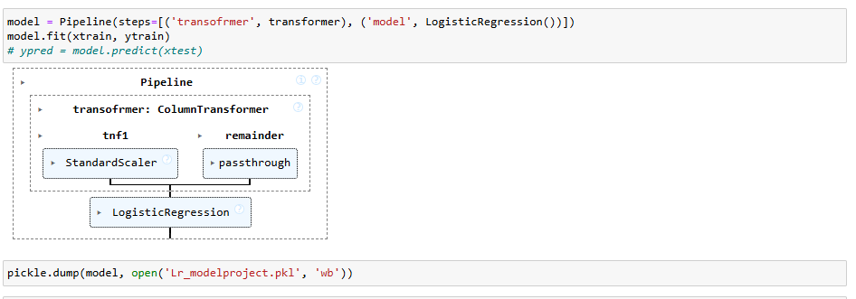
pipeline
Here we converted all the columns into pipeline by using data transformer steps to be taken on such as standardization, fitting classification and training and testing.
And later we saved the file into pickle library.

Slide 26
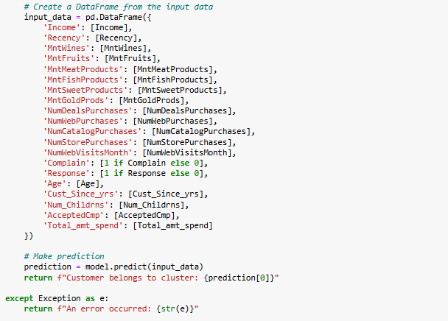
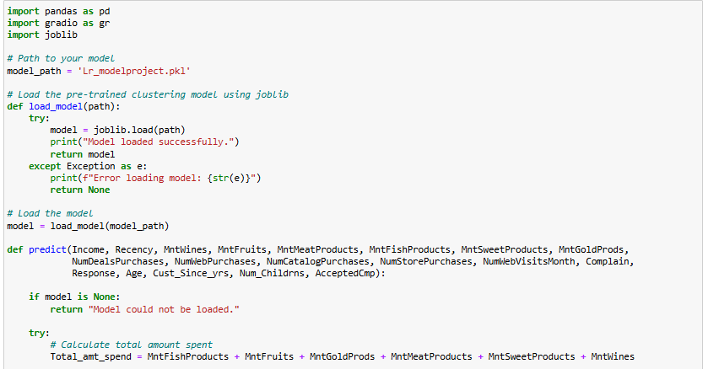
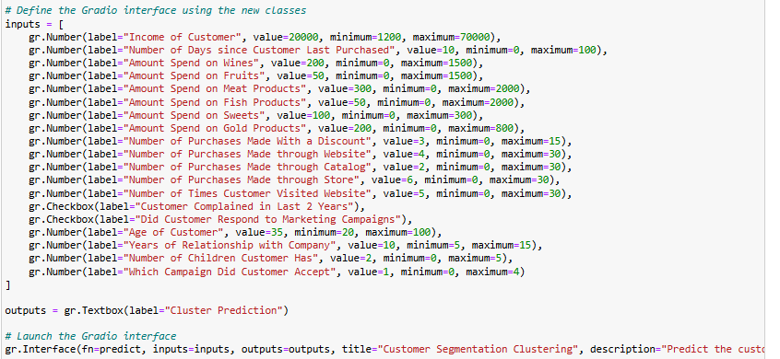
Deployment code
We loaded a pipeline model and created a function to predict classification.
We created a user interface using gradio to get a proper inputs and outputs.

Slide 27
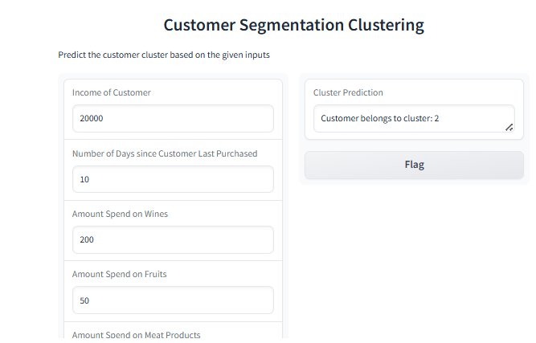
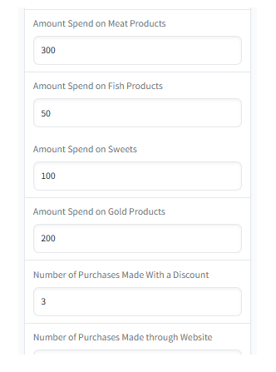
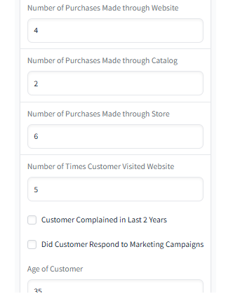
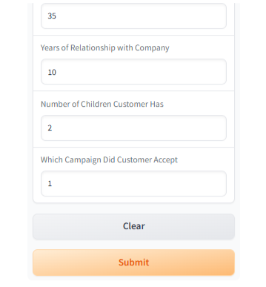
Deployment output

Slide 28
Challenges faced
Ensuring the accuracy and consistency of the data across different datasets is crusial but can be difficult due to data discrepancies and incomplete information.
Choosing the right segmentation techniques and algorithms that suits the specific business needs and datasets characteristics can be complex and require expertise.
Handling the large volume of data efficiently and processing it in a timely manner Can be significant challenge, especially in real time segmentation projects.
And the most challenging step was to creating a pipeline and deploying the model, we feel it’s a very complex thing to do.

Slide 29
THANK YOU

